Slide 1
School Re-opening
September 2020
.

Slide 2
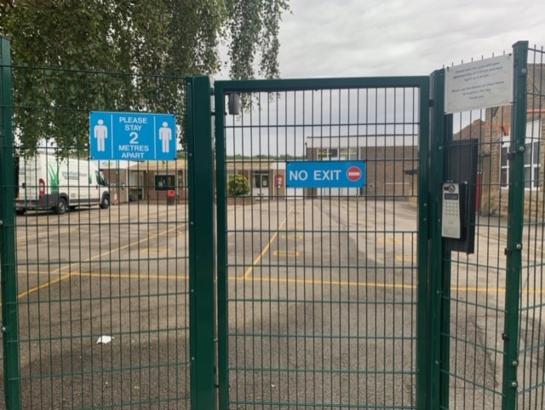
RAVENFIELD PRIMARY ACADEMY|PAGE TITLE
When you arrive
Welcome back to school. You might be a little bit nervous but we are all looking forward to seeing you again.
When you arrive, you will notice signs on the gates at the front. You will enter through the normal gate marked ‘NO EXIT’.

Slide 3
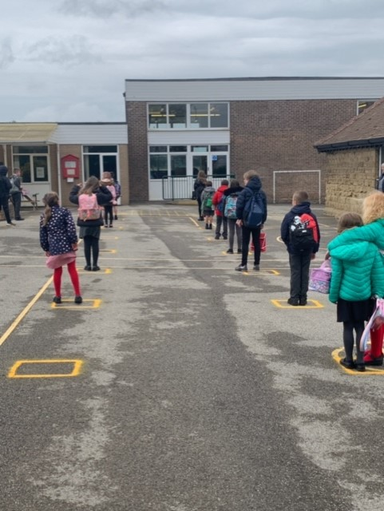
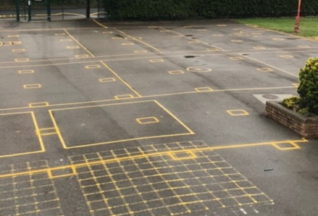
RAVENFIELD PRIMARY ACADEMY|PAGE TITLE
The playground when you arrive
When you get on to the playground. You will with your parents on the dots to the right of the playground (or where Mrs Coates directs you to) until your teacher arrives. You will then stand in the boxes (as modelled by our fabulous pupils in the picture on the right). Your grown ups will then leave you with your teacher before entering the school. Parents, if you need to communicate with a teacher, please call the school or use Dojo.
If you arrive at a different time, Mrs Coates will be on the playground to take you to your class.

Slide 4
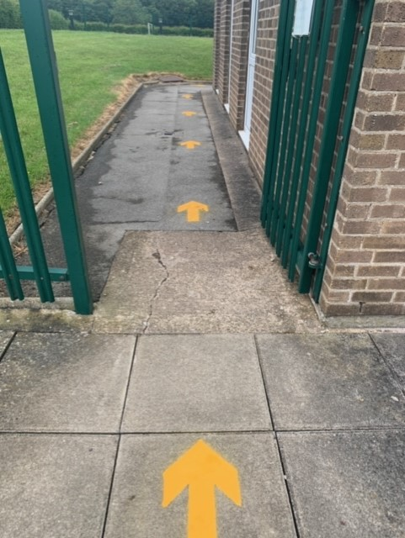
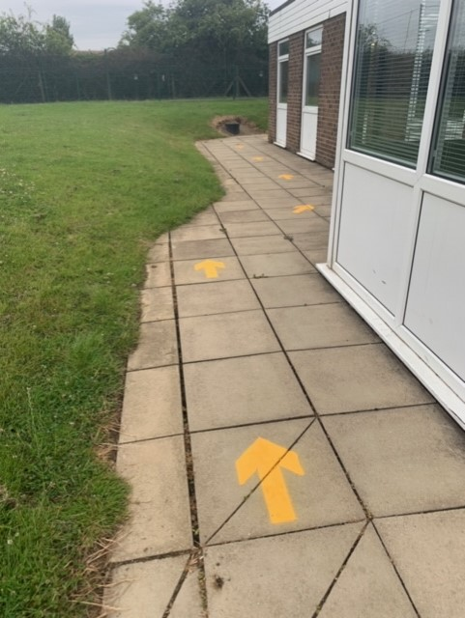
RAVENFIELD PRIMARY ACADEMY|PAGE TITLE
Going into your classroom
You will notice lots of yellow arrows. These show you which way you should travel around school. However, your teacher or grown up with be with you.
These will lead you straight to your classroom.

Slide 5
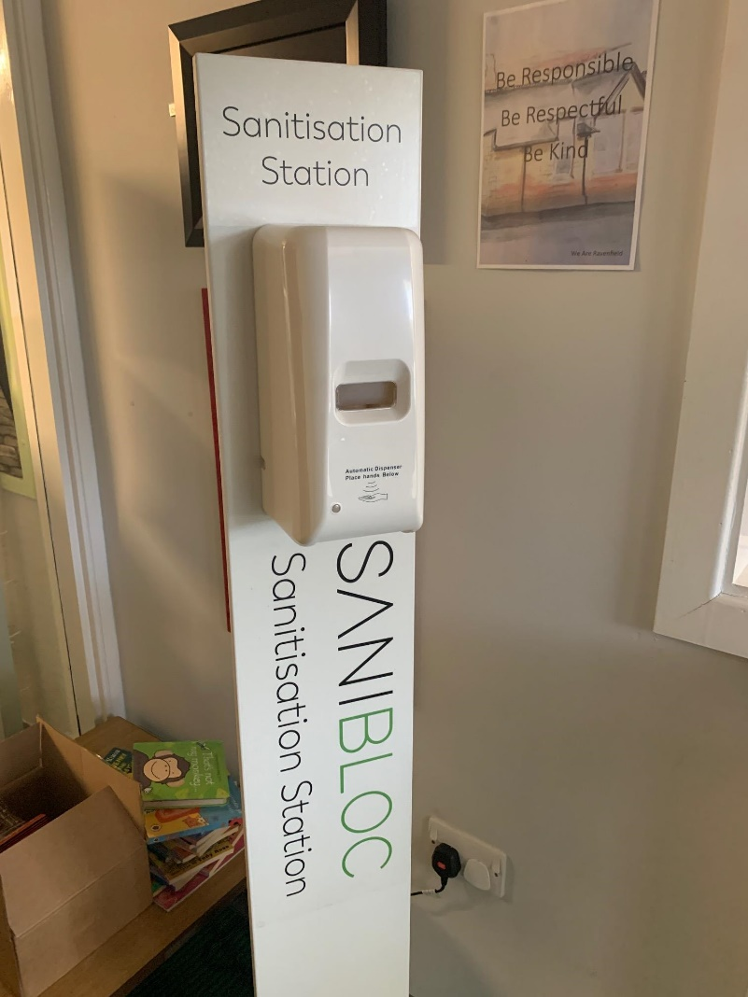
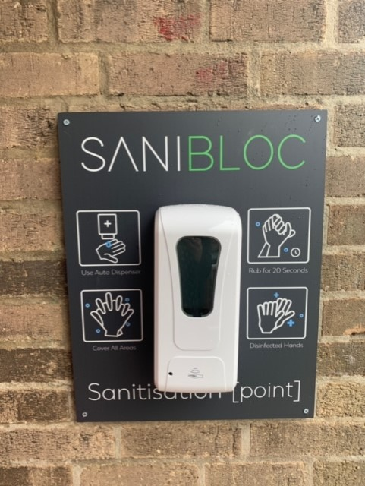
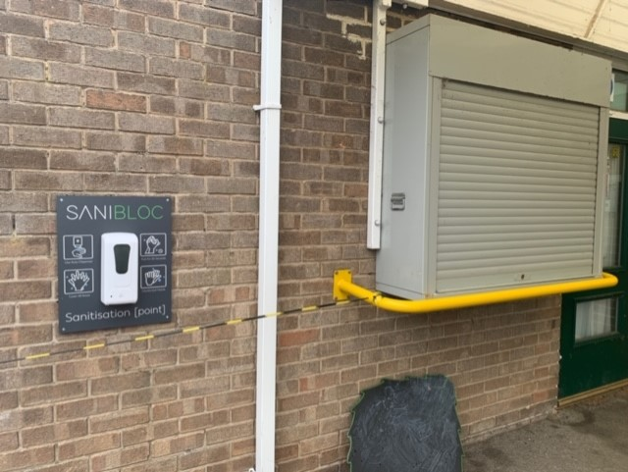
RAVENFIELD PRIMARY ACADEMY|PAGE TITLE
Entering your classroom
When you enter the school, you will see these new hand sanitiser machines. They are all around the school and at every entrance. All you need to do is put your hand under the machine and it will squirt some hand sanitiser onto your hands.

Slide 6
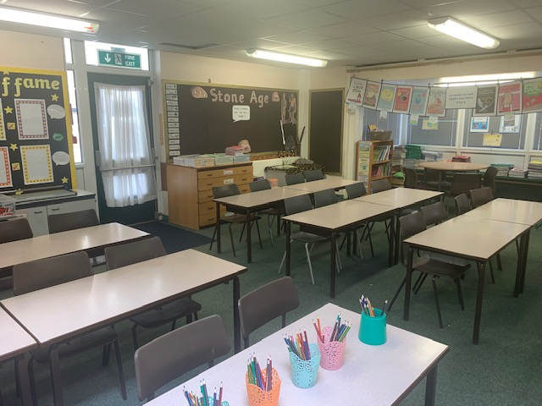
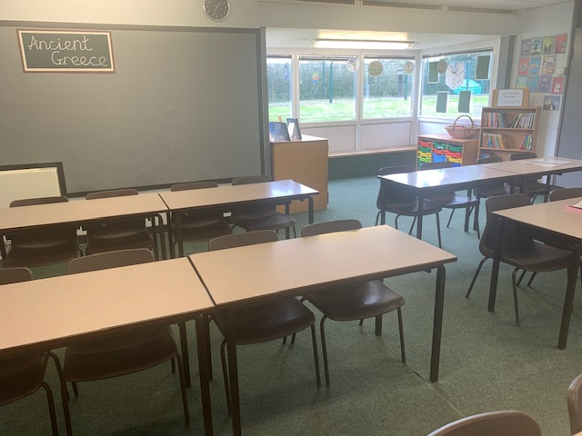
RAVENFIELD PRIMARY ACADEMY|PAGE TITLE
In the classrooms there are now seats for more children.

Slide 7
RAVENFIELD PRIMARY ACADEMY|PAGE TITLE
Break time
You will have a break-time during the morning session.
There may be two class bubbles having a break at the same time.
You must remain in the area allocated by your teacher and not cross into another classes bubble.

Slide 8
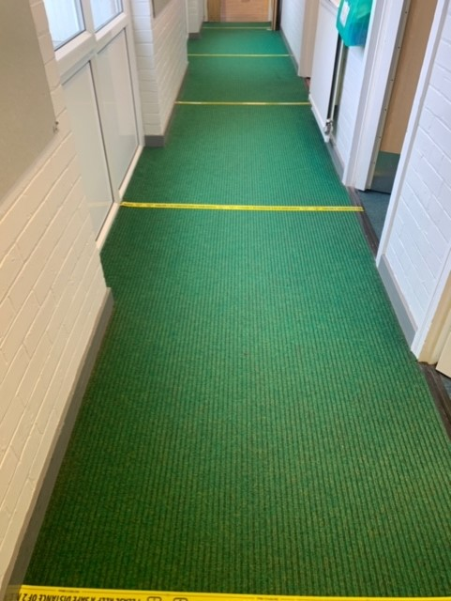
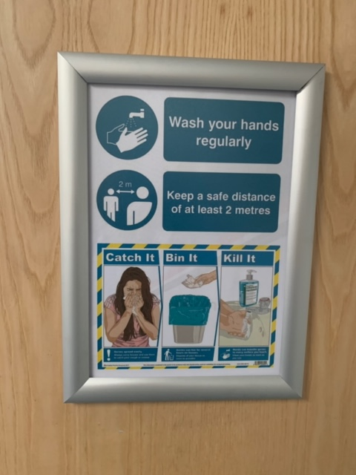
RAVENFIELD PRIMARY ACADEMY|PAGE TITLE
Moving around school
During the day, you will not need to walk around the rest of the school as you will have lessons and your dinner in your bubble classroom.
However, if you have to, you will see taped lines across the floor to help people
keep 2 metres apart.
You will also see lots of signs to
remind us all to keep safe.

Slide 9
RAVENFIELD PRIMARY ACADEMY|PAGE TITLE
Lunch
During lunchtime, you will have one hour.
30 minutes in class to eat your dinner.
30 minutes outside on the playground.
Each class will have a designated SMSA, who will be with them for the entire lunch period.
Lunches ordered will be delivered to class and any lunch boxes will be stored underneath the child’s peg.

Slide 10
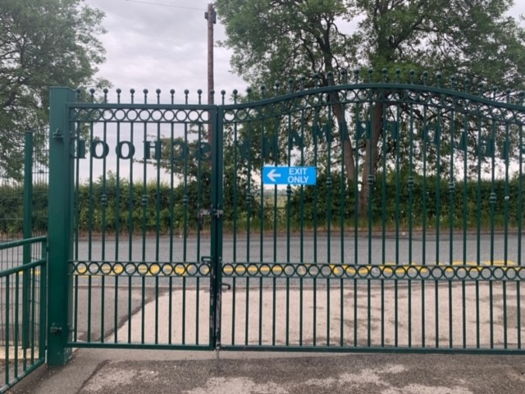
RAVENFIELD PRIMARY ACADEMY|PAGE TITLE
When you leave
When you leave, your teacher will take you to the front playground, where your grown up will be waiting for you.
You will then leave out of the gate marked ‘EXIT ONLY’.
We can’t wait to see you all!

Slide 11
THANK YOU

